Slide 1
Recursion
Lindenmayer Systems (L-Systems)
http://fractalfoundation.org/OFC/OFC-2-1.html

Slide 2
Recursion
In some problems, it may be natural to define the problem in terms of the problem itself.
Recursion is useful for problems that can be represented by a simpler version of the same problem.
Example: the factorial function
6! = 6 * 5 * 4 * 3 * 2 * 1
We could write:
6! = 6 * 5!

Slide 3
Factorial function
In general, we can express the factorial function as follows:
n! = n * (n-1)!
Is this correct? Well… almost.
The factorial function is only defined for positive integers. So we should be a bit more precise:
n! = 1 (if n is equal to 1)
n! = n * (n-1)! (if n is larger than 1)

Slide 4
Factorial function
The C++ equivalent of this definition:
int fac(int numb){
if(numb<=1)
return 1;
else
return numb * fac(numb-1);
}

Slide 5
Factorial function
Assume the number typed is 3, that is, numb=3.
3 <= 1 ? No.
fac(3) = 3 * fac(2)
fac(2) :
2 <= 1 ? No.
fac(2) = 2 * fac(1)
fac(1) :
1 <= 1 ? Yes.
return 1
int fac(int numb){
if(numb<=1)
return 1;
else
return numb * fac(numb-1);
}
fac(2) = 2 * 1 = 2
return fac(2)
fac(3) = 3 * 2 = 6
return fac(3)
fac(3) has the value 6

Slide 6
Factorial function
For certain problems (such as the factorial function), a recursive solution often leads to short and elegant code. Compare the recursive solution with the iterative solution:
Recursive solution
int fac(int numb){
if(numb<=1)
return 1;
else
return numb*fac(numb-1);
}
Iterative solution
int fac(int numb){ int product=1; while(numb>1){ product *= numb; numb--; }
return product
}

Slide 7
Tail Recursion
Recursion
Price of recursion:
calling a function consumes more time and memory than adjusting a loop counter
high performance applications (graphic action games, simulations of nuclear explosions) hardly ever use recursion
Recursion is one way to decompose a task into smaller subtasks
At least one of the subtasks is a smaller example of the same task
The smallest example of the same task has a non-recursive solution

Slide 8
Tail Recursion
Tail Recursion
A recursive function is tail recursive when recursive call is the last thing executed by the function
Example: function print() is tail recursive
void print(int n)
{
if (n < 0) return;
cout << " " << n;
// The last executed statement is recursive call
print(n-1);
}

Slide 9
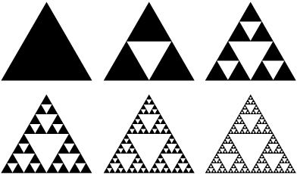
Sierpinski triangle

Slide 10

Sierpinski triangle
Start with an equilateral triangle
$\text{Height} h=\frac{\sqrt{3}}{2}a$

